Slide 1

Introduction to MIPS Addressing Language
MIPS is a Reduced Instruction Set Computing (RISC) architecture widely used in embedded systems and computer architecture education. Its addressing language allows efficient memory access, essential for program execution.
B.SWATHI
B.SC/CS

Slide 2
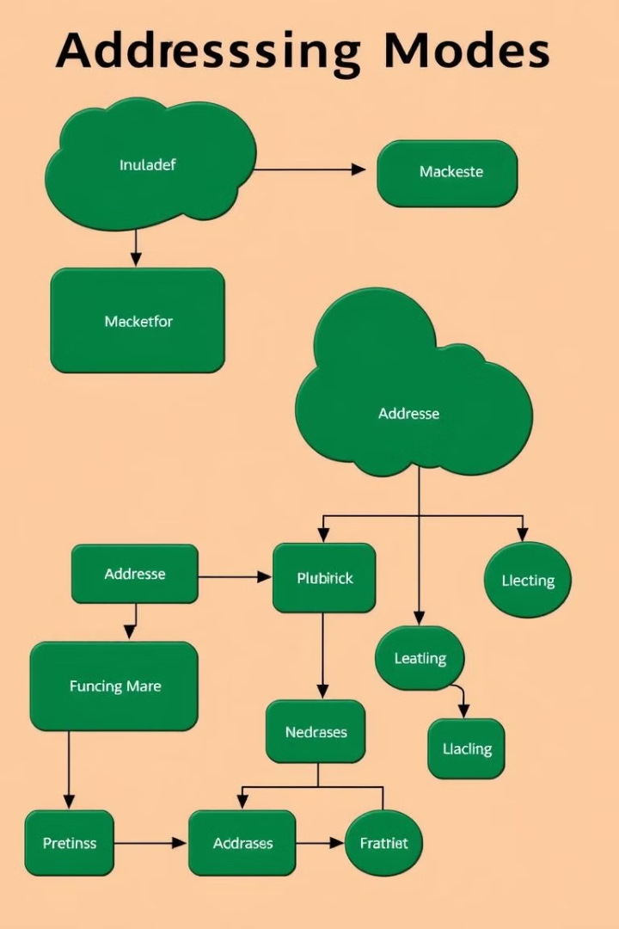
Addressing Modes in MIPS
1
Immediate Addressing
2
Register Addressing
The operand is the value stored in a register, providing fast access.
The operand is a constant value directly embedded in the instruction.
3
Base Addressing
4
Pseudodirect Addressing
The operand's address is calculated by adding an offset to the value of a base register.
A special case where the operand's address is directly encoded within the instruction.

Slide 3
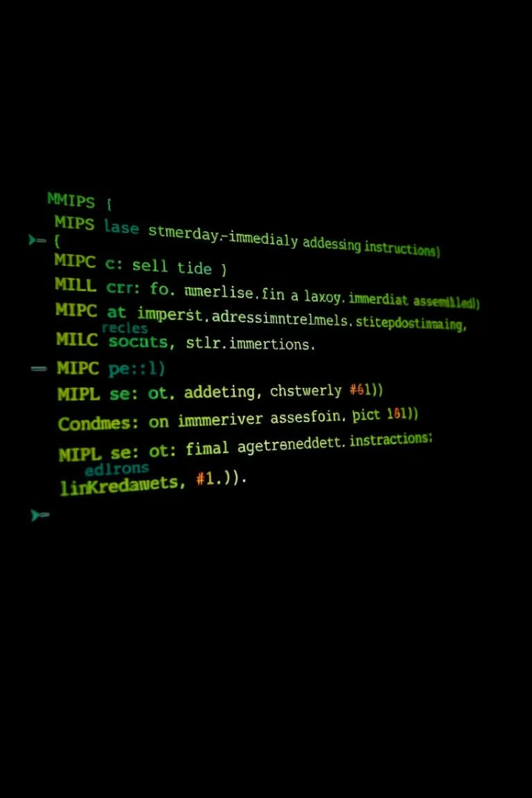
Immediate Addressing
Immediate addressing simplifies instructions by directly using constant values as operands. This is efficient for small, known values, often used for loop counters or literal values.
Instruction
Explanation
addi $t0, $zero, 10
Adds the immediate value 10 to register $zero and stores the result in $t0
ori $t1, $t1, 0x10
Performs a bitwise OR operation between register $t1 and the immediate value 0x10, storing the result in $t1

Slide 4
Register Addressing
Register addressing uses registers to hold operands, enabling fast access and efficient processing. This mode is commonly used for frequently accessed variables or intermediate results.
Advantages
Disadvantages
Fast access to data. Efficient for frequently used values.
Limited register space, requiring data movement.
High bandwidth between registers and the ALU.
Can lead to memory access when registers are full.

Slide 5
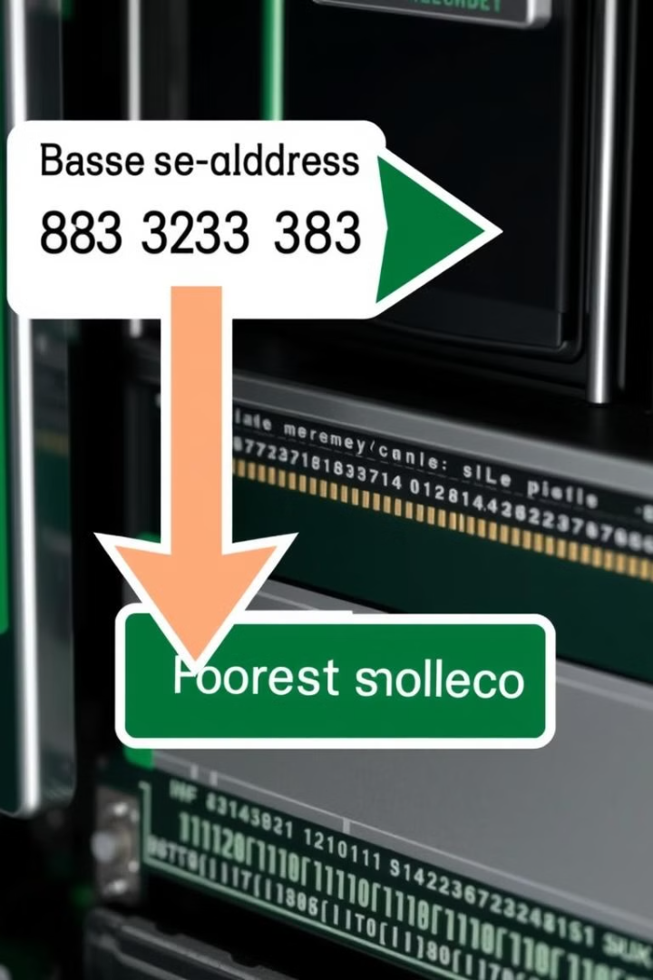



Base Addressing
Base addressing uses a base register and an offset to calculate the effective memory address. This allows accessing data in a contiguous memory region relative to a base pointer.
Base Register
A register that holds the starting address of a data structure.
Offset
A constant value added to the base address to reach the desired memory location.
Effective Address
The final address of the operand in memory.

Slide 6
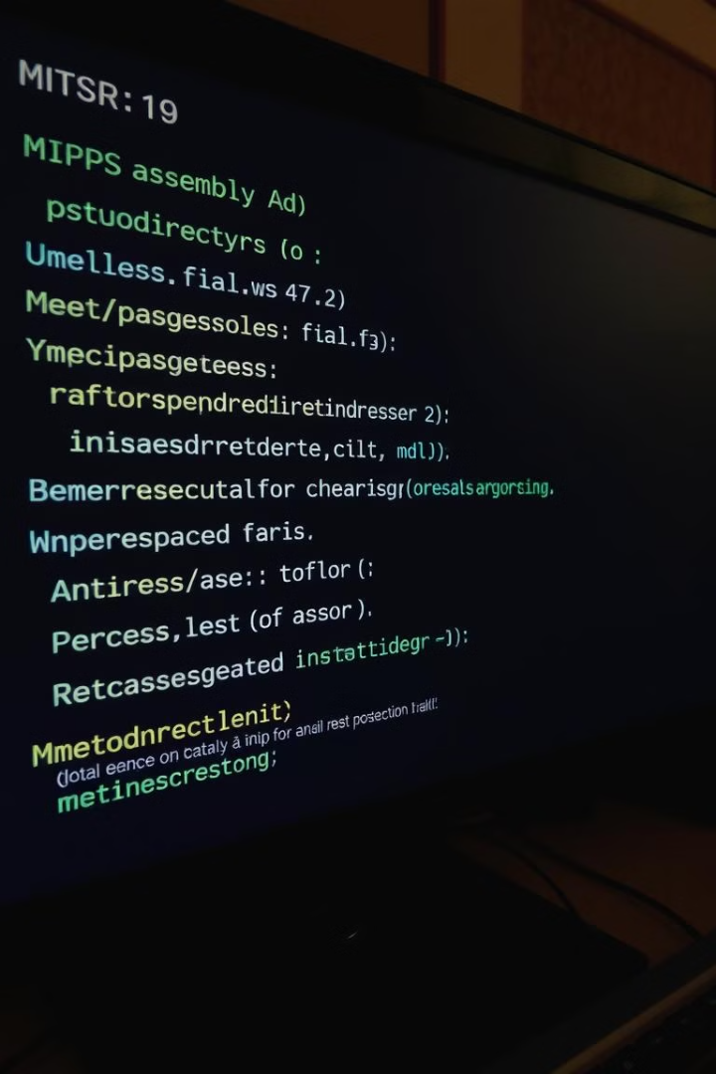
Pseudodirect Addressing
Pseudodirect addressing is a specialized addressing mode where the operand's address is encoded directly within the instruction. This is often used for frequently accessed code sections or constant values.
The instruction format encodes the address as a fixed offset from the PC (Program Counter), enabling quick access and saving instruction space.

Slide 7





Addressing Arithmetic Operations
MIPS supports various arithmetic operations, often involving addressing modes for efficient data manipulation. These operations are crucial for program execution and data processing.
Addition
Subtraction
Multiplication
Division
Adds two operands, commonly used in calculations and data manipulation.
Subtracts one operand from another, often used in calculations and comparisons.
Multiplies two operands, commonly used in calculations and data scaling.
Divides one operand by another, often used in calculations and data scaling.

Slide 8
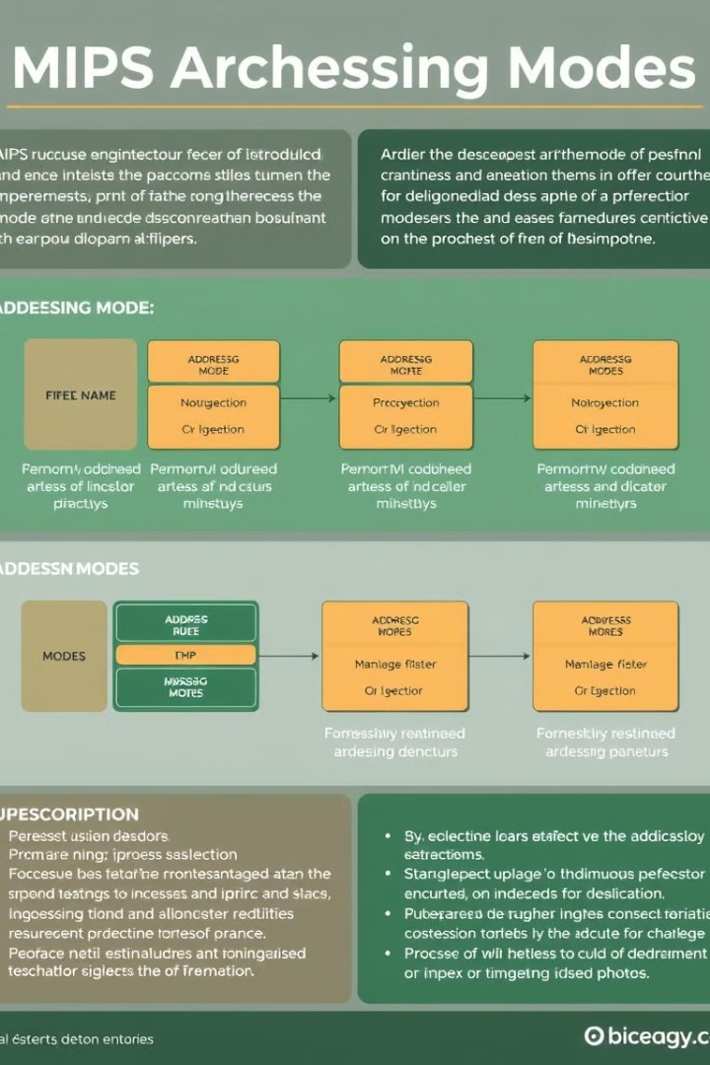
Conclusion and Summary
MIPS addressing modes are critical for efficient memory access and data manipulation. By understanding these modes, developers can write optimized and efficient programs for various applications.
Choosing the appropriate addressing mode depends on the specific program requirements, data access patterns, and performance goals.

Slide 9

THANK YOU

